Slide 1
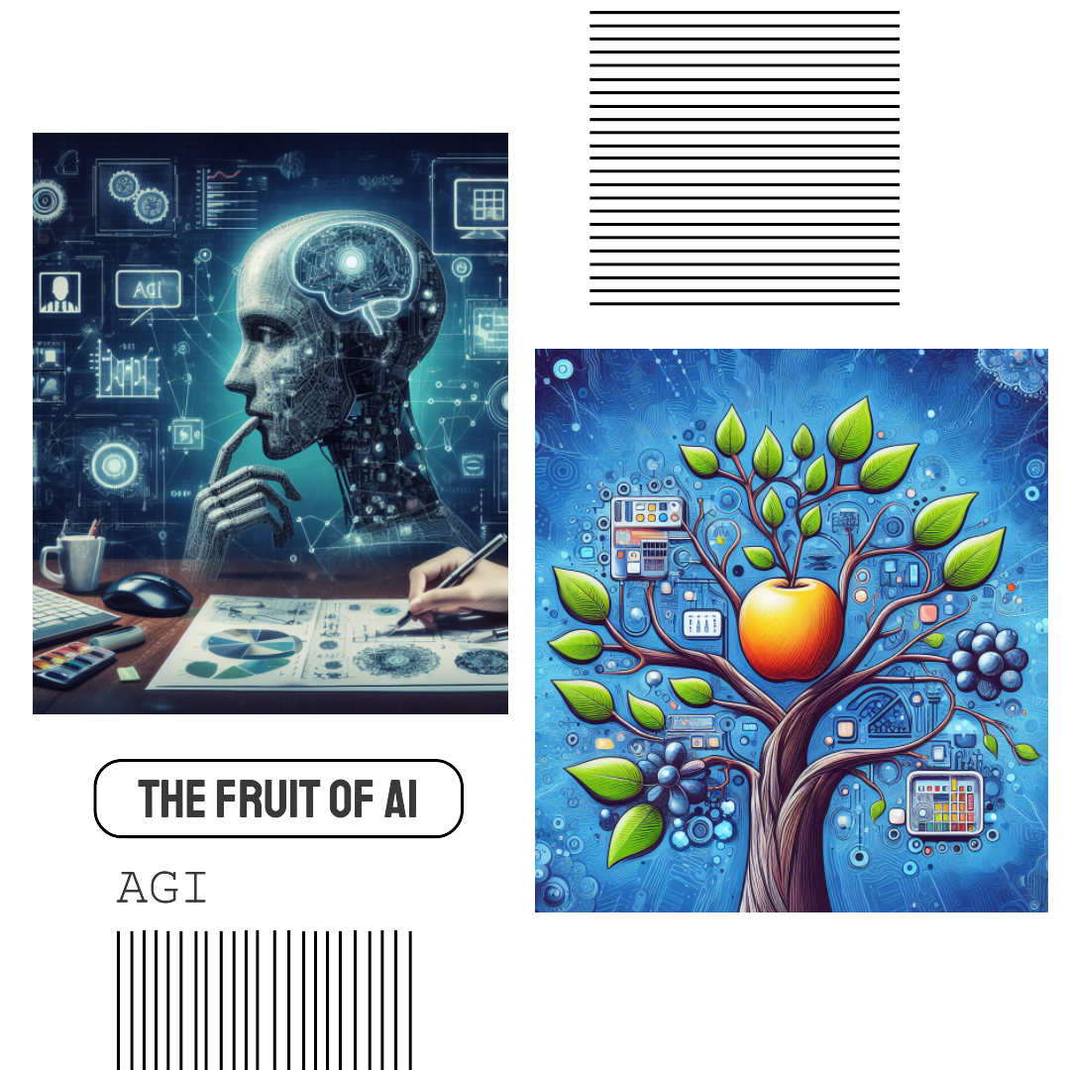
Artificial General Intelligence (AGI) is a theory in the domain of computer science and robotics. Imagine a machine that can process information, learn, and understand in a manner like human beings. AGI has the potential to aid us in making more informed decisions. By rapidly analyzing a huge amount of data, AGI could offer valuable insights that would otherwise remain hidden. AI excels at specific tasks. On the other hand, AGI, or Artificial General Intelligence, operates on the premise that a machine can learn and develop by understanding from experiences and interactions. AGI could optimize the medical field by analyzing vast amounts of patient data, including medical records, genetic information, and real-time health monitoring data. By identifying patterns and correlations that might elude human doctors, AGI could provide more accurate and timely diagnoses, leading to earlier interventions and improved patient outcomes. However, as of now, AGI remains theoretical and is a subject of ongoing research. Researchers are persistently striving to realize this concept.

